Slide 1

A
MICRO PROJECT
Intelligent Agent based Job Search System
BACHELOR OF TECHNOLOGY
In
COMPUTER SCIENCE & ENGINEERING
BY
V.AARUSHI :
A.VARSHINI :
S.SAI KIRAN :
K. VALLA RAJU :
L.SHABBIR :
23Q91A05P9
23Q91A05J1
24Q95A0522
23Q91A05L9
24Q95A0521
Under the Guidance of
Mrs. L. SUNITHA
ASST.PROFESSOR,Dept.of.CSE
DEPARTMENT OF COMPUTER SCIENCE & ENGINEERING
MALLA REDDY COLLEGE OF ENGINEERING
(Approved by AICTE - Permanently Affiliated to JNTU-Hyderabad)
Accredited by NBA & NAAC, Recognized section2(f) &12(B) of UGC New Delhi ISO 9001:2015 Certified Institution
Maisammaguda, Dhulapally (Post via Kompally) Secunderabad – 500100
2024-2025
1

Slide 2
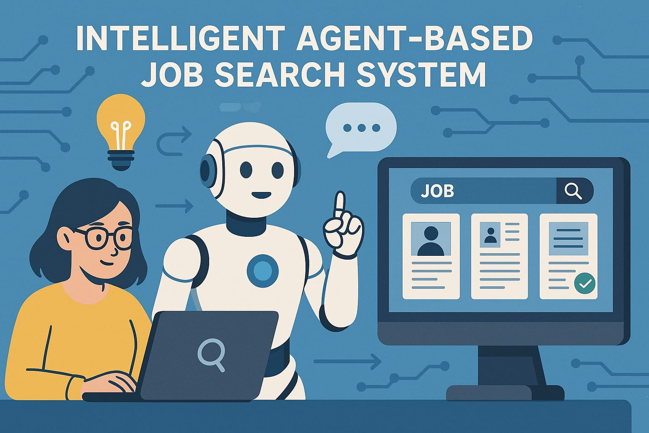
05
CONTENTS
Abstract
Introduction
Existing System
Proposed System
System Requirements
Conclusion
References
2

Slide 3

ABSTRACT
Job searching can be time-consuming and inefficient due to the vast number of job listings and application processes. An Intelligent Agent-Based Job Search System leverages artificial intelligence and automation to streamline this process. The system uses intelligent agents to collect job listings from various sources, analyse user profiles, and match them with suitable opportunities based on skills, experience, and preferences. It automates resume customization, application submissions, and provides real-time notifications on job updates. By integrating machine learning and natural language processing, the system enhances job recommendation accuracy, reduces search time, and improves user experience. This approach optimizes job hunting, making it more effective and efficient for job seekers.
3

Slide 4
INTRODUCTION
Normally when we want to apply for a job, we search the newspapers; listen to radio and television broadcasts that may advertise vacancies and also job seekers register themselves with job site portals such as Academickeys.com, Monster.com, and Careerbuilder.com and so on. In general, employers do not register themselves with these mediums to provide full details of the job specifications but instead post important details on their own website only. Also with the growing number of online job search engines, making it almost impossible for job seekers to get an overview of all relevant positions.
4

Slide 5

EXISTING SYSTEM
The existing system for job recruitment includes traditional methods like Employment agencies, advertising through newspapers, televisions and radios, college fairs etc., which are too slow and stressful. With the advancement of internet, jobseekers rely on the online job portals, which make the job search efficient. Again, most of these are limited to the web/desktop applications, which requires jobseekers to have a laptop or desktop connected to internet and is not handy. And disadvantages include: Time Consuming, Stressful, and Challenging.
5

Slide 6
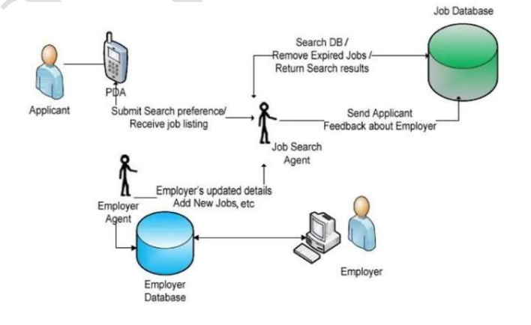
PROPOSED SYSTEM :
Proposed System: Job Search System is a Python-based android application that provides devices like Android based smart phones/tablets. Advantages: Cost and Time efficient, portable. Purpose of the System: Job Search System is developed to provide an effective means for the employers to post job openings with required qualification to have a better penetration into the job market and jobseekers to find out the information regarding the current openings in the organization or in the market. In addition, job seekers can view the reviews provided by the applicants to make necessary improvements in their system if needed. Job search System is an android application providing flexibility for the users.
6

Slide 7

SYSTEM REQUIREMENTS
HARDWARE REQUIREMENTS:
Processor : Dual Core CPU (2.0 GHz)
Storage : 50 GB HDD.
Ram : 4 GB
SOFTWARE REQUIREMENTS:
Operating system : Windows 10/11
Coding Language : python
Database : MYSQL , Firebase
7

Slide 8
CONCLUSION
The Intelligent Agent-Based Job Search System offers a smart, efficient, and accessible solution to the limitations of traditional and web-based job search platforms. By leveraging mobile technology and intelligent agents, this system enables both job seekers and employers to interact seamlessly, especially in underserved or rural areas . The app simplifies the job search process by considering user preferences such as location, skills, and compensation, while also providing job recommendations and reviews. Its offline capability and user-friendly design make it especially useful for individuals seeking quick, local, and small-scale employment opportunities.
8

Slide 9

REFERENCES
[1] Mochol , Malgorzata, et al. "Improving the accuracy of job search with semantic techniques." 2007.
[2] Franklin, Stan, and Art Graesser . "Is it an Agent, or just a Program? A Taxonomy for Autonomous Agents." 1996.
[3] Jennings, N. R., and M. Wooldridge. "Applications of Intelligent Agents." 1998.
[4] Hayes-Roth, B. "An Architecture for Adaptive Intelligent Systems." 1995.
9

Slide 10

10

